Slide 1

Product managers in academia: taking your research out of the lab July 28, 2022
Dr Alden Conner (she/her)
Research Application Manager
Tools, Practices, and Systems Programme

Slide 2
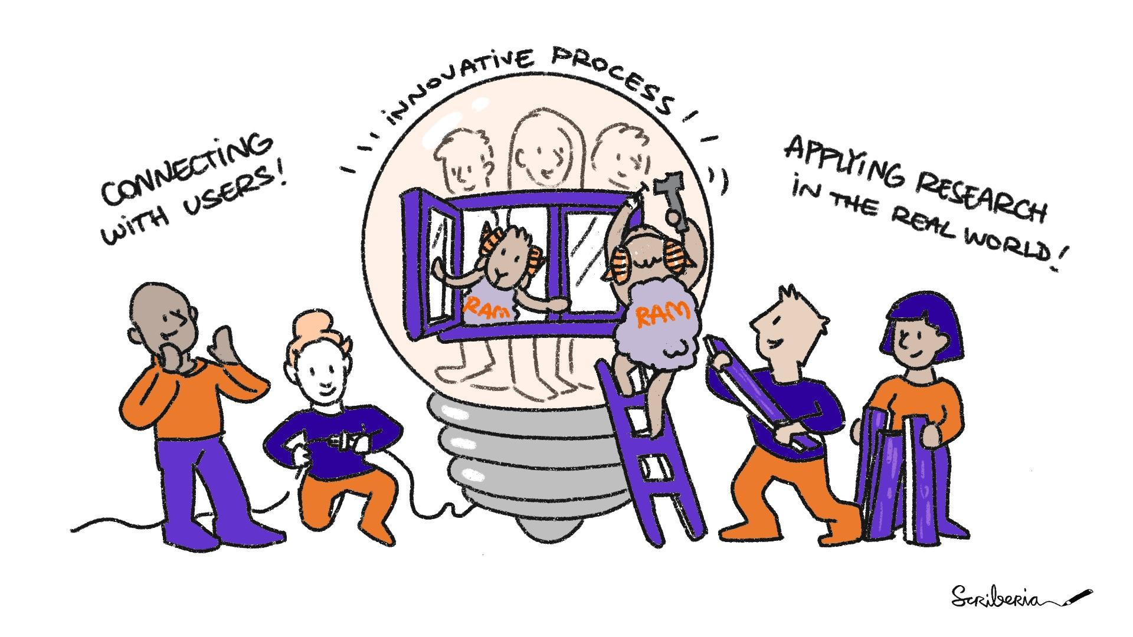
Research Application Managers
Research Application Managers (RAM) enhance the real-world impact of the research output by focussing on the user perspective
Inspired by the role of Product Manager
Notes:
act as a user advocate/user representative embedded within the research team
Identify users, scope project with timelines and deliverables (roadmap), prioritize features, manage documentation and training materials
Often times academic projects languish once the original researcher has moved on, we want to ensure longevity and sustainability

Slide 3
product idea
value proposition
business
requirements
specs
sales
engineers
engagement
PM
development
testing
scientists
users
feedback
Notes:
So what does a product manager do?

Slide 4
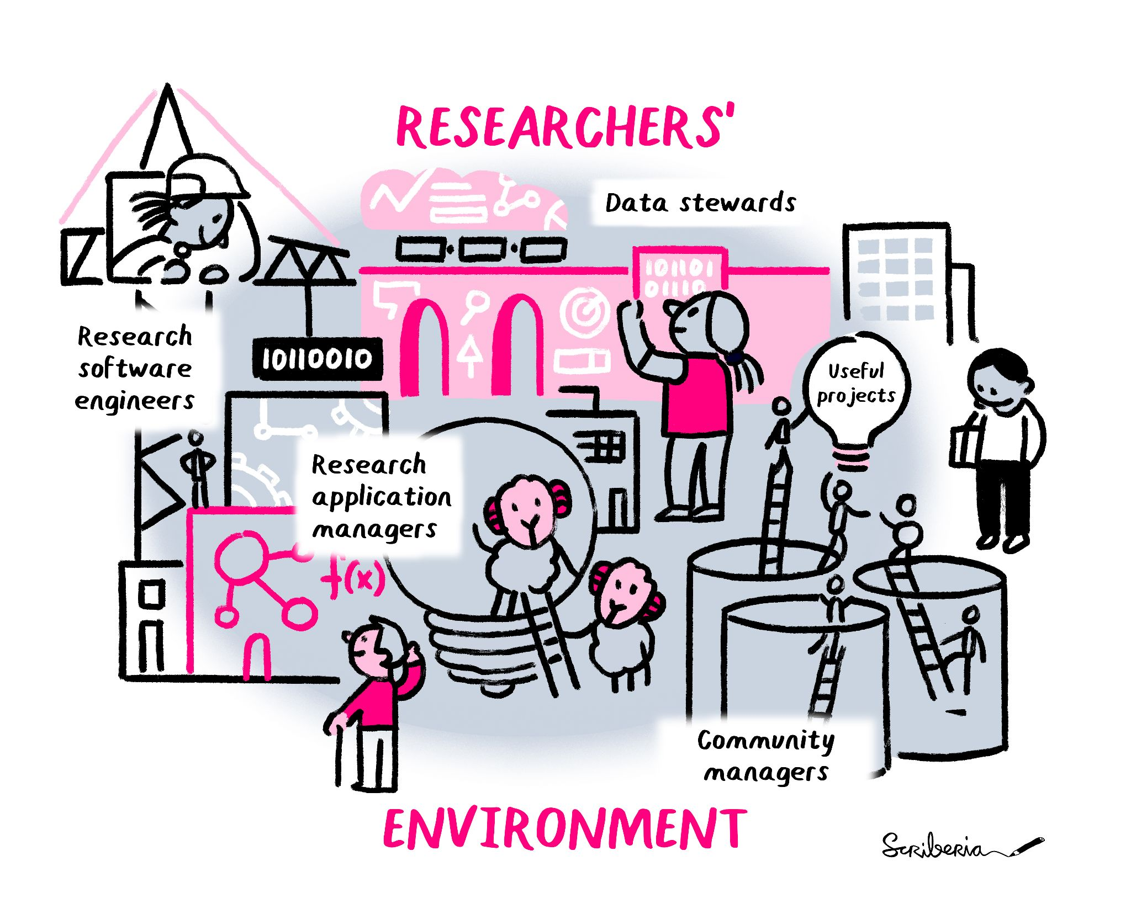
Team science
Data Stewards
Research Software Engineers
Community Managers
Research Application Managers (RAMs)
Notes:
Why do we need a product manager in academia and where do they fit in?
How we structure our work
Research Software engineers can bridge data, software and domain expertise.
Data stewards can communicate data management practices with domain experts and members of the public.
Community managers can support the training and upskilling of all members of the collaboration, to make sure that everyone can participate in the conversation and can be part of an inclusive co-creation process.
RAMs bring in the users - the people (beyond just the members of the public) who will benefit from this work. They can make sure that our research projects move from being open and technically usable to actually used in the real world.

Slide 5
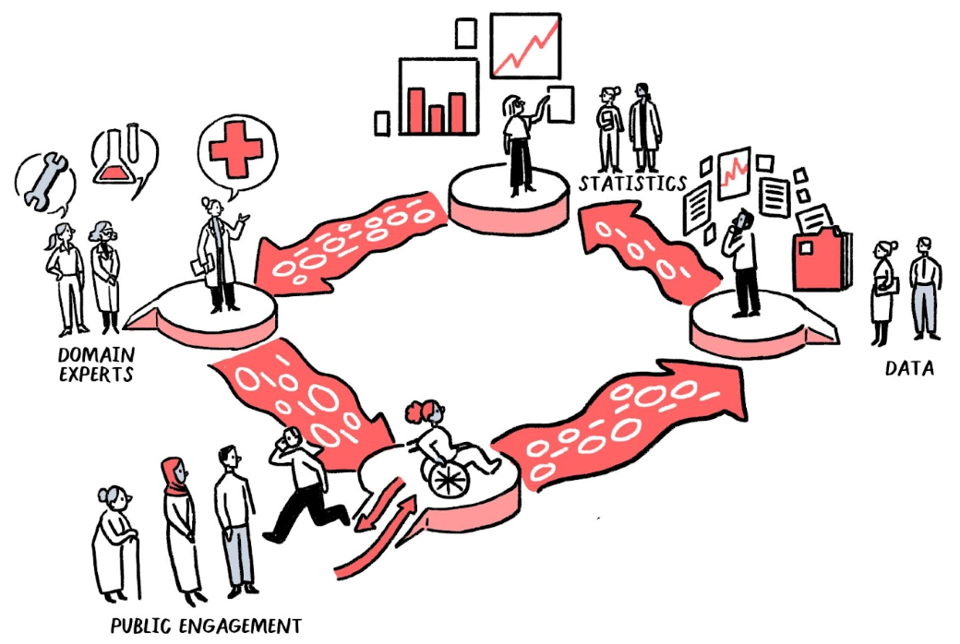
Collaboration in action
Leveraging expertise from different areas strengthens research
Public engagement steers us towards impact
Collaboration brings its own challenges
All images by The Turing Way community and Scriberia under CC-BY 4.0 License
Notes:
How does a team science mentality contribute to better collaboration?
Identify the right questions – bring different experts and public input
Engineers, statisticians, science communications, data scientists
Cycle will repeat
want to enable the process to run smoothly and upskill participants to make sure they can contribute in a meaningful way

Slide 6
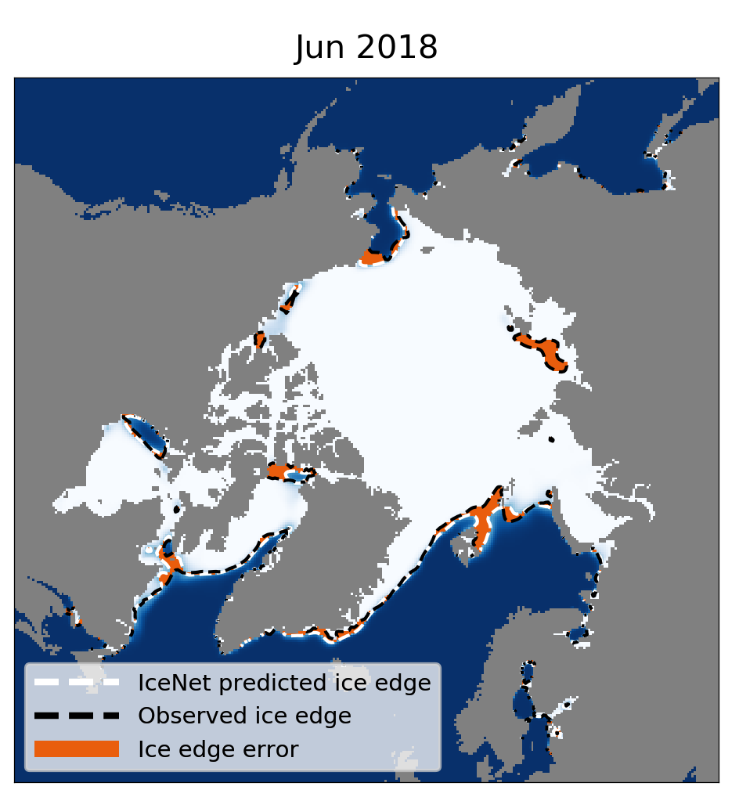
IceNet: diverse user needs
IceNet v1 is almost 95% accurate in predicting whether sea ice will be present two months ahead – v2 will provide daily forecasts
Polar scientists: route planning
Indigenous communities: hunting
Conservation scientists: animal migrations
Notes:
IceNet as a case study
Need external engagement to drive features for different uses – both on the research side (what outputs will the forecast provide) and the development side (how will be deliver the forecast)
Breakout to discuss how you would train these different user groups and get feedback from them that would help us improve the technology?

Slide 7
Acknowledgements
RAM team: Aida Mehonic, Jennifer Ding, Hari Sood
IceNet team: Tom Andersson, James Byrne, Scott Hosking (British Antarctic Survey)
Original artwork by Scriberia: doi.org/10.5281/zenodo.3332807

Slide 8
Keep in touch!
aconner@turing.ac.uk
ram@turing.ac.uk
github.com/alan-turing-institute/research-application-management

